Slide 1
Futures Markets and Central Counterparties
Chapter 2

Slide 2
Futures Contracts
Available on a wide range of underlyings
Exchange traded
Specifications need to be defined:
  What can be delivered,
  Where it can be delivered,
  When it can be delivered
Settled daily

Slide 3
Convergence of Futures to Spot (Figure 2.1, page 28)
Futures
Price
Spot Price
Spot Price
Futures
Price
Time
Time
(a)
(b)

Slide 4
Margin
Margin is cash or marketable securities deposited by an investor with his or her broker
The balance in the margin account is adjusted to reflect daily settlement
Margin minimizes the possibility of a loss through a default on a contract
Retail traders provide initial margin and, when the balance in the margin account falls below a maintenance margin level, they must provide variation margin bringing balance back up to initial margin level.

Slide 5
Example of a Futures Trade (page 29-30)
A retail investor takes a long position in 2 December gold futures contracts
  contract size is 100 oz.
  futures price is US$1250
  initial margin requirement is US$6,000/contract (US$12,000 in total)
  maintenance margin is US$4,500/contract (US$9,000 in total)

Slide 6
A Possible Outcome (Table 2.1, page 30)
Day | Trade Price ($) | Settle Price ($) | Daily Gain ($) | Cumul. Gain ($) | Margin Balance ($) | Margin Call ($)
1 | 1,250.00 |  |  |  | 12,000
1 |  | 1,241.00 | −1,800 | − 1,800 | 10,200
2 |  | 1,238.30 | −540 | −2,340 | 9,660
….. |  | ….. | ….. | ….. | ……
6 |  | 1,236.20 | −780 | −2,760 | 9,240
7 |  | 1,229.90 | −1,260 | −4,020 | 7,980 | 4,020
8 |  | 1,230.80 | 180 | −3,840 | 12,180
….. |  | ….. | ….. | ….. | ……
16 | 1,226.90 |  | 780 | −4,620 | 15,180

Slide 7
Key Points About Futures
They are settled daily
Closing out a futures position is easy. It involves entering into an offsetting trade
Most contracts are closed out before maturity

Slide 8
Exchange Clearing House
The exchange clearing house has members who provide initial margin and daily variation margin
Brokers who are not members must channel their business through a member. The member will then require margin from the broker

Slide 9
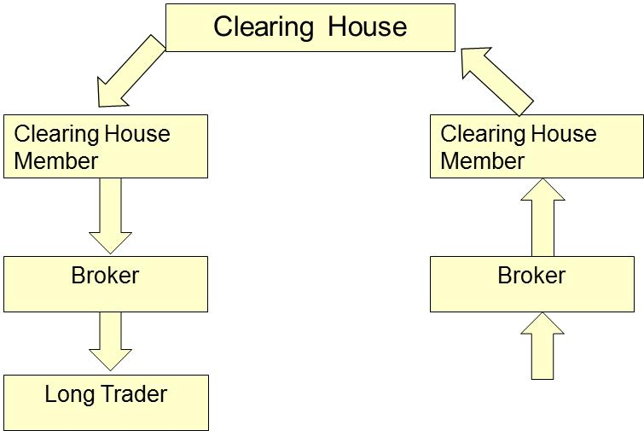

Margin Cash Flows When Futures Price Increases

Slide 10
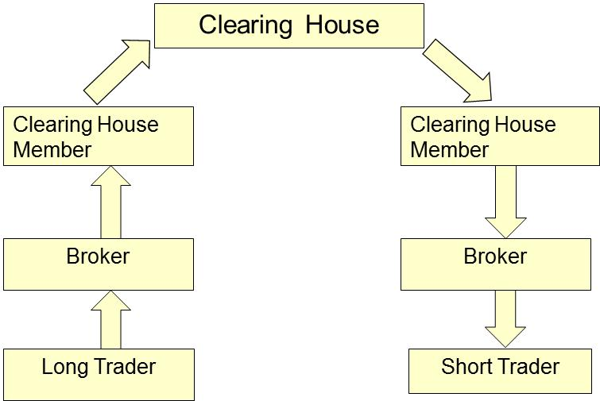
Margin Cash Flows When Futures
Price Decreases

Slide 11
OTC Markets: Bilateral Clearing
Transactions governed by an agreement, typically an ISDA Master Agreement, between two sides
A credit support annex (CSA) defines the collateral that has to be posted by each side

Slide 12
CCPs and OTC Markets
Following the 2007-2009 crisis, there has been a requirement for standardized OTC derivatives transactions between financial institutions to be cleared centrally though clearing houses known as central counterparties (CCPs)

Slide 13
Operation of CCPs
The operation of a CCP is very similar to that of an exchange clearing house
It has members who provide initial margin (based on their outstanding contracts with the CCP) and variation margin
If not a member, a company can clear its transactions through a member

Slide 14
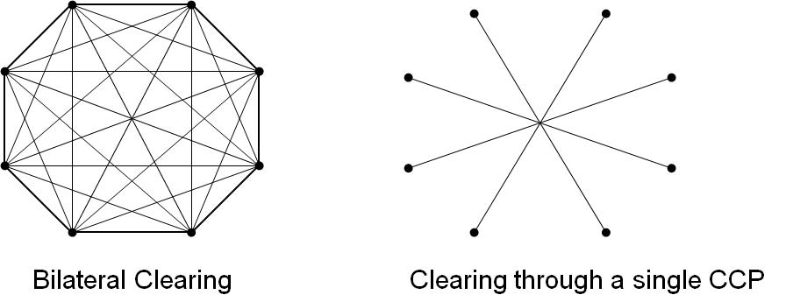
Bilateral Clearing vs Central Clearing
CCP
CCCCCP

Slide 15
Some Terminology
Open interest: the total number of contracts outstanding
  equal to number of long positions or number of short positions
Settlement price: the price just before the final bell each day
  used for the daily settlement process
Volume of trading: the number of trades in one day

Slide 16
Crude Oil Trading on May 13, 2015 (from Table 2.2, page 36)
 | Open | High | Low | Prior settle | Last trade | Change | Volume
Jun 2015 | 61.23 | 61.85 | 60.19 | 60.75 | 60.20 | −0.55 | 379,797
Sept 2015 | 63.30 | 63.49 | 62.03 | 62.58 | 62.03 | −0.55 | 39,663
Dec 2015 | 64.22 | 64.39 | 63.05 | 63.58 | 63.05 | −0.53 | 54,902
Dec 2016 | 65.82 | 65.99 | 64.86 | 65.48 | 64.91 | −0.57 | 20,212
Dec 2017 | 66.86 | 67.08 | 66.25 | 66.83 | 66.25 | −0.58 | 3,087

Slide 17
Delivery
If a futures contract is not closed out before maturity, it is usually settled by delivering the assets underlying the contract. When there are alternatives about what is delivered, where it is delivered, and when it is delivered, the party with the short position chooses.
A few contracts (for example, those on stock indices and Eurodollars) are settled in cash
When there is cash settlement contracts are traded until a predetermined time. All are then declared to be closed out.

Slide 18
Futures Price Patterns
Futures prices can be
  an increasing function of maturity: normal market
  a decreasing function of maturity: inverted market
  partly normal, partly inverted

Slide 19
Questions
When a new trade is completed what are the possible effects on the open interest?
Can the volume of trading in a day be greater than the open interest?

Slide 20
Types of Orders
Limit
Stop-loss
Stop-limit
Market-if touched
Discretionary
Time of day
Open
Fill or kill

Slide 21
Regulation of Futures
Regulation is designed to protect the public interest
Regulators try to prevent questionable trading practices by either individuals on the floor of the exchange or outside groups

Slide 22
Accounting & Tax
It is logical to recognize hedging profits (losses) at the same time as the losses (profits) on the item being hedged
It is logical to recognize profits and losses from speculation as they are incurred
Roughly speaking, this is what the accounting and tax treatment of futures in the U.S. and many other countries attempts to achieve

Slide 23
Forward Contracts
A forward contract is an OTC agreement to buy or sell an asset at a certain time in the future for a certain price
There is no daily settlement (but collateral may have to be posted). At the end of the life of the contract one party buys the asset for the agreed price from the other party
Notes:
10

Slide 24
Profit from a Long Forward or Futures Position
Profit
Price of Underlying
at Maturity
Notes:
14

Slide 25
Profit from a Short Forward or Futures Position
Profit
Price of Underlying
at Maturity
Notes:
15

Slide 26
Forward Contracts vs Futures Contracts (Table 2.3, page 43)
FORWARDS
FUTURES
Private contract between 2 parties
Exchange traded
Non-standard contract
Standard contract
Usually 1 specified delivery date
Range of delivery dates
Settled at end of contract
Settled daily
Delivery or final cash
settlement usually occurs
prior to maturity
Some credit risk
Virtually no credit risk

Slide 27
Foreign Exchange Quotes
Futures exchange rates are quoted as the number of USD per unit of the foreign currency
Forward exchange rates are quoted in the same way as spot exchange rates. This means that GBP, EUR, AUD, and NZD are USD per unit of foreign currency. Other currencies (e.g., CAD and JPY) are quoted as units of the foreign currency per USD.
Notes:
17

